Slide 1

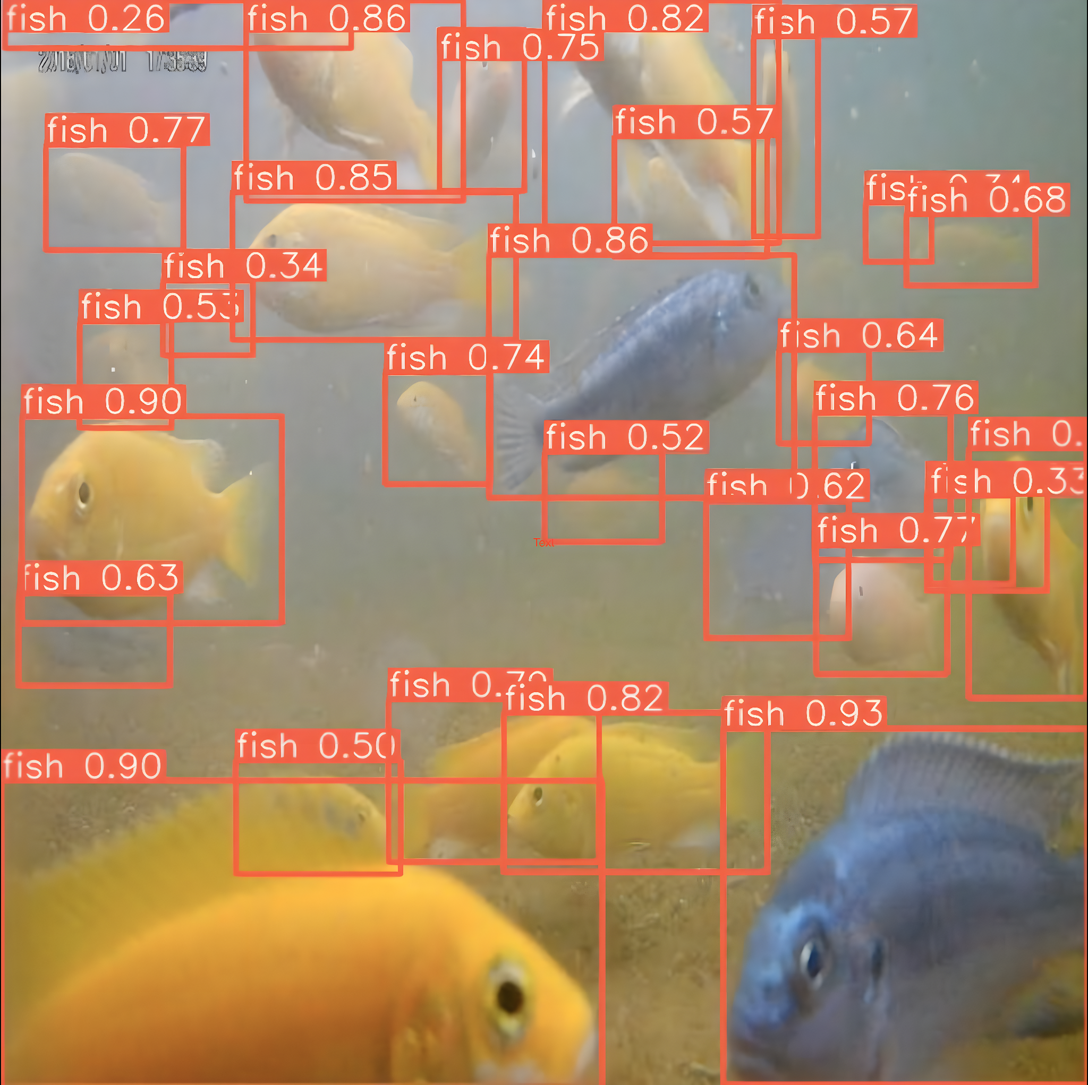
Team Detectron
DePondFi '23
Detection of Pond Fish 2023 Challenge
*actual model predictions

Slide 2

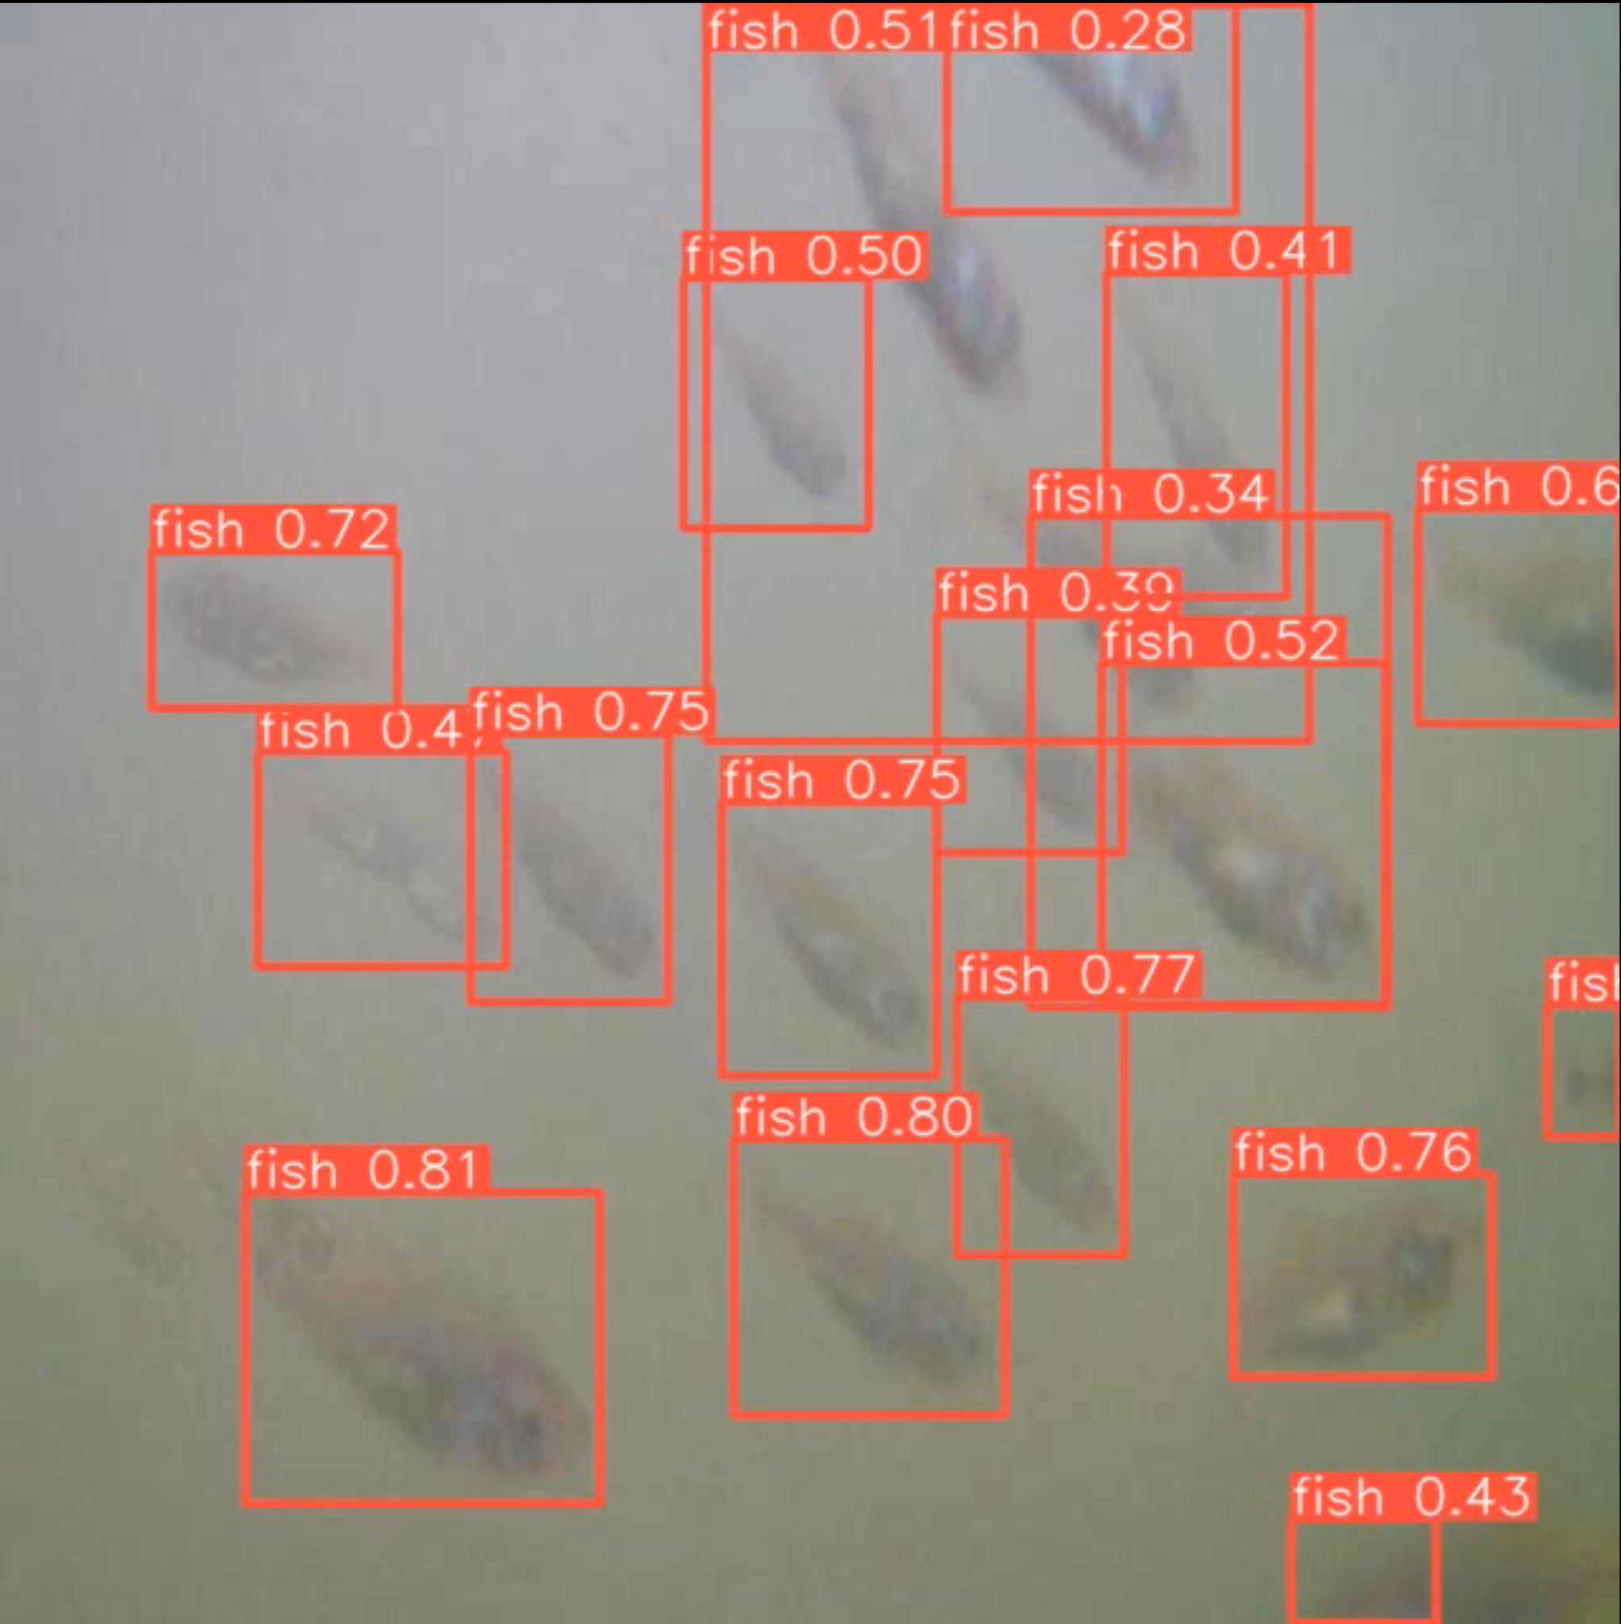





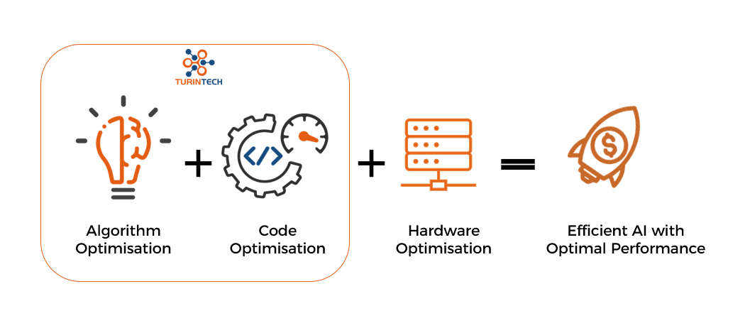
The GOAL
Research existing object detection algorithms
Improvise the pipeline for Robustness
Accurate + Optimal Fish Detection
Implement and benchmark the algorithm

Slide 3
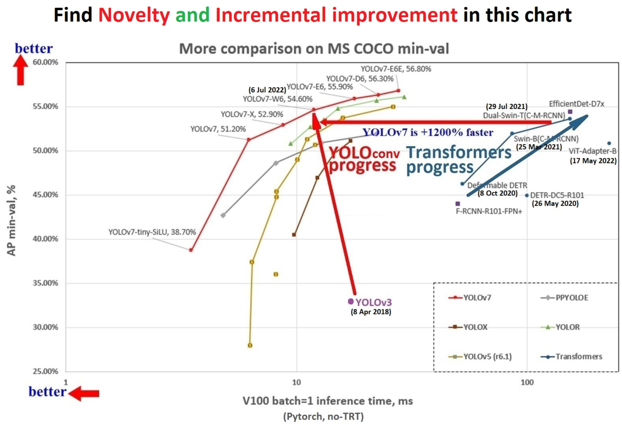
Why YOLO?
YOLO outperforms transformers on COCO dataset [https://arxiv.org/pdf/2207.02696.pdf]

Slide 4
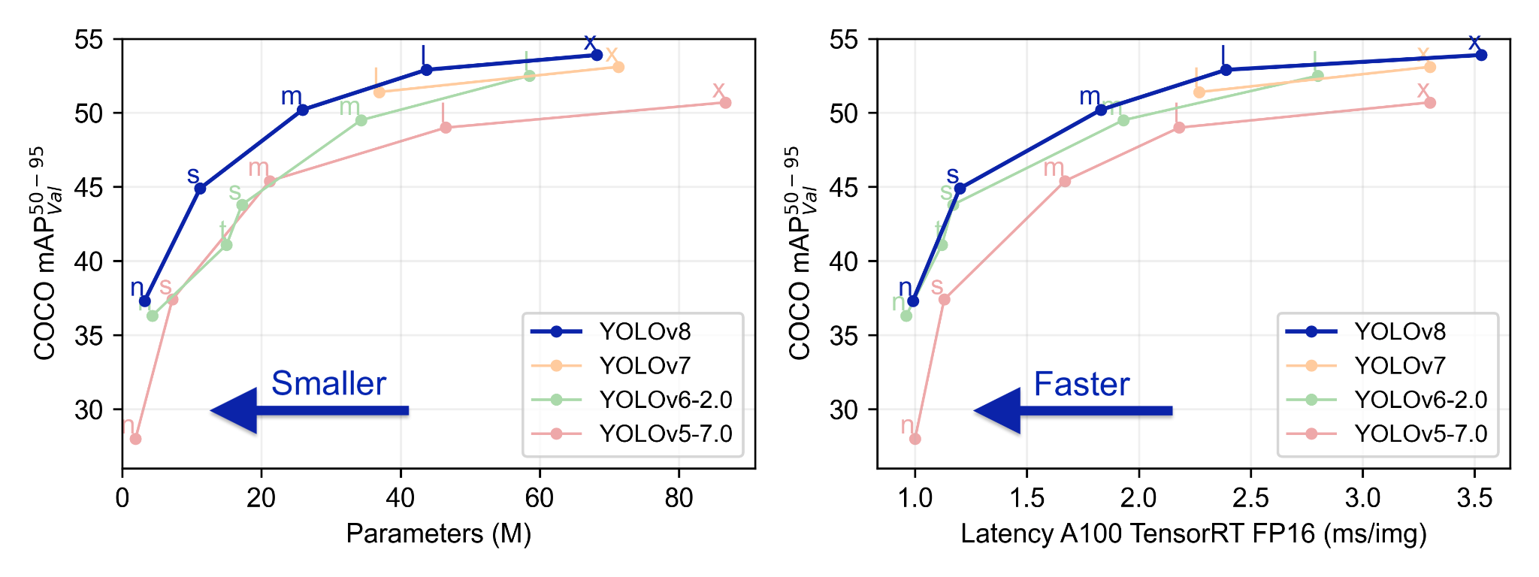
YOLOv8
YOLOv8 compared with other YOLO models [ultralytics.com]

Slide 5
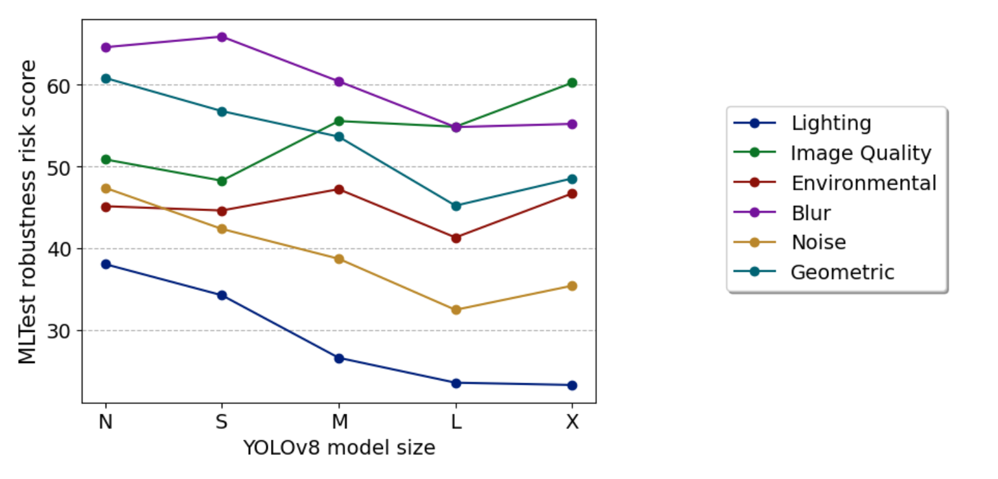
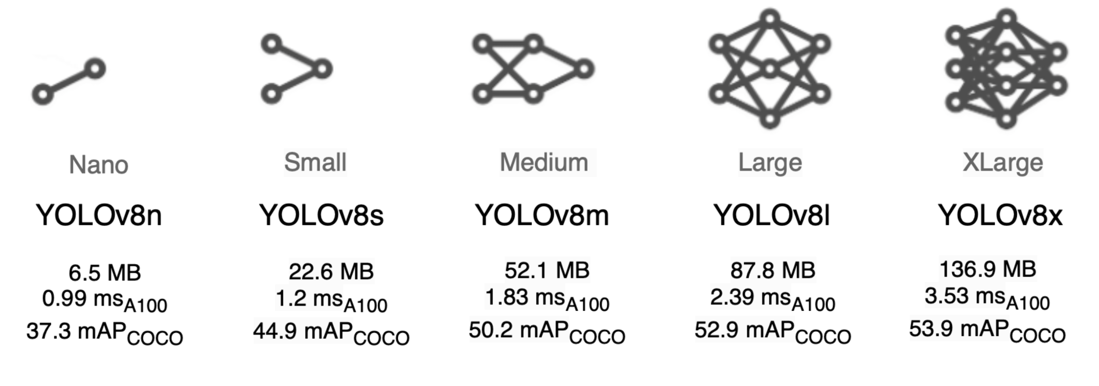
Experimentations
#1
Model | mAP50 val | Inference Time* Tesla T4, TensorRT | Parameters
YOLOv8n | 0.915 | 34.17 sec | 3.2 M
YOLOv8s | 0.922 | 42.94 sec | 11.2 M
YOLOv8m | 0.922 | 46.78 sec | 25.9 M
*Total Inference Time calculated on given 1100 Test Images
Lower
is better
www.lakera.ai/insights/pre-trained-poor-generalization
“Larger models are not universally better. Within the YOLO family, there is no significant and consistent increase in robustness as models expand and in some risk factors like Image quality, it even gets worse.”
YOLO model sizes [ultralytics.com]

Slide 6
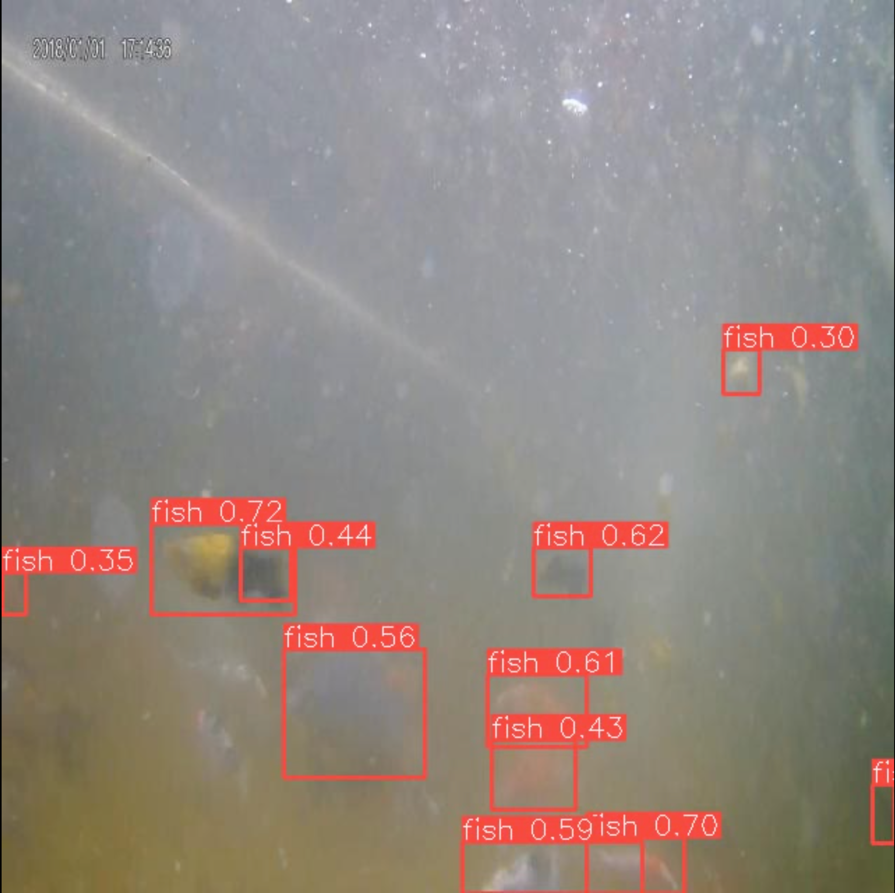
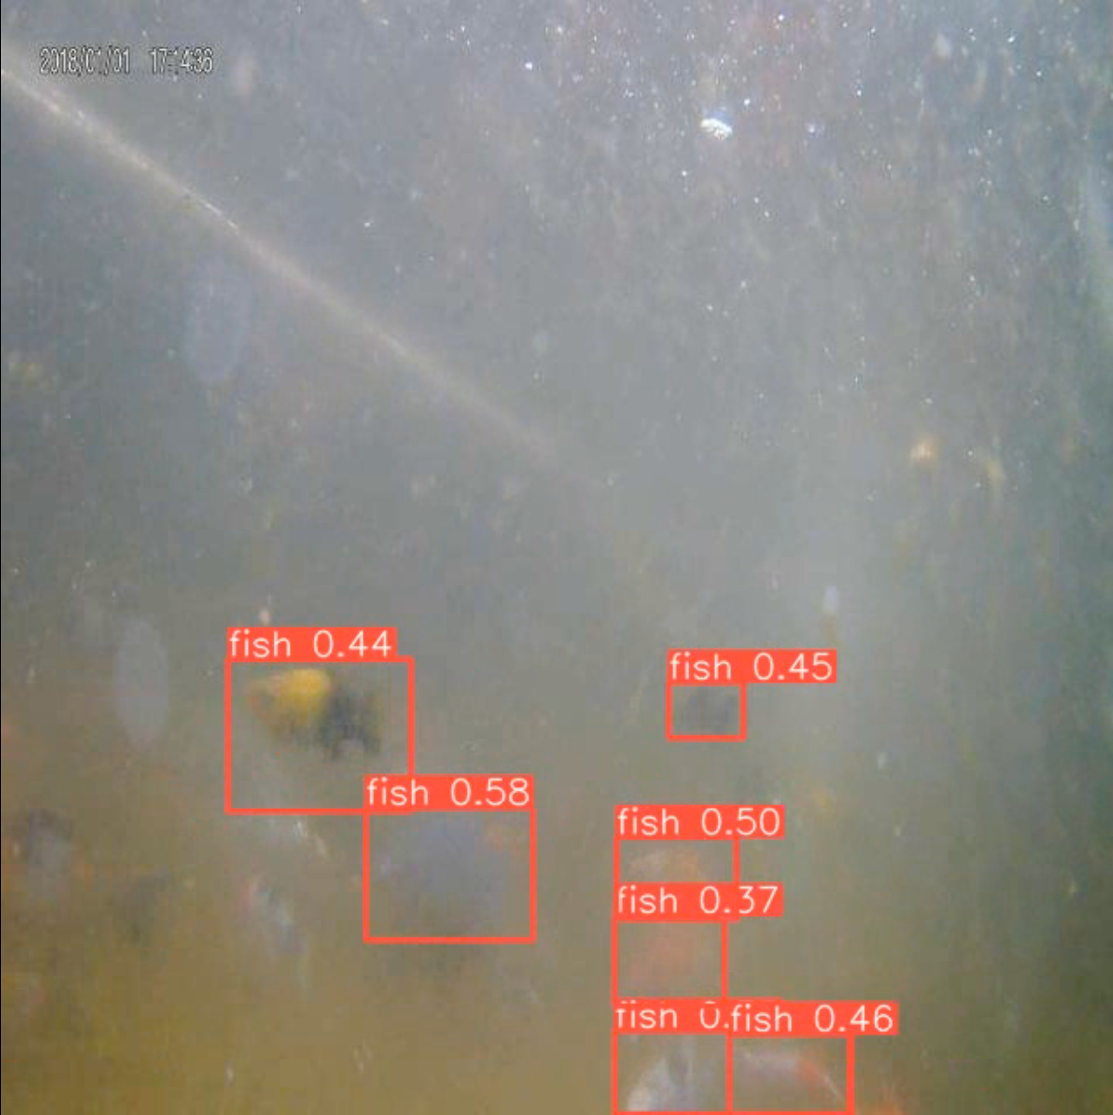
SAHI: Slicing Aided Hyper Inference
#2
What is it?
Performing inference over smaller slices of the original image and then merging the sliced predictions on the original image.
github.com/obss/sahi
Pipeline | Inference Time Tesla T4, PyTorch | mAP50 val
Yolov8n | 39.42 sec | 0.915
Yolov8n + SAHI | 314 sec | 0.795
*Total Inference Time calculated on given 1100 Test Images
slice_height = 213
slice_width = 213
overlap_height_ratio = 0.2
overlap_width_ratio = 0.2
parameters in SAHI as it works best in our case.
Prediction with YOLOv8n+SAHI
Prediction with YOLOv8n

Slide 7
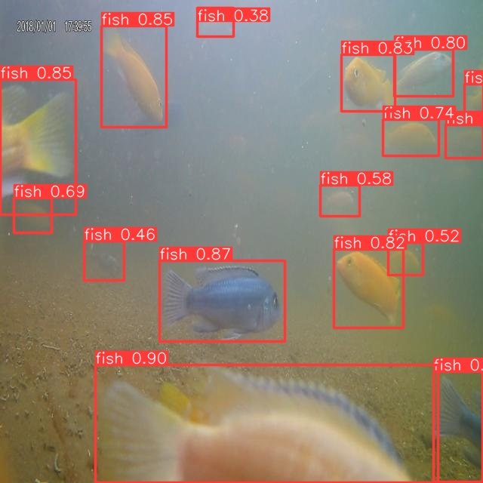
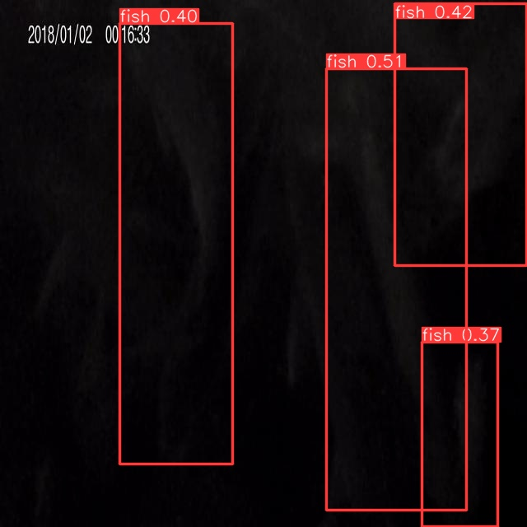
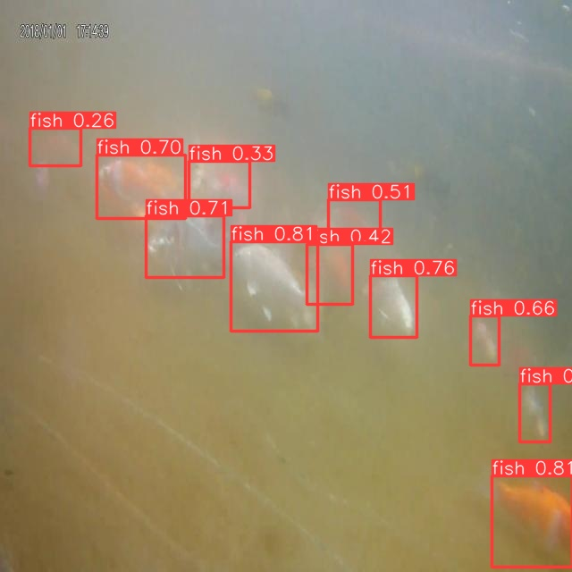
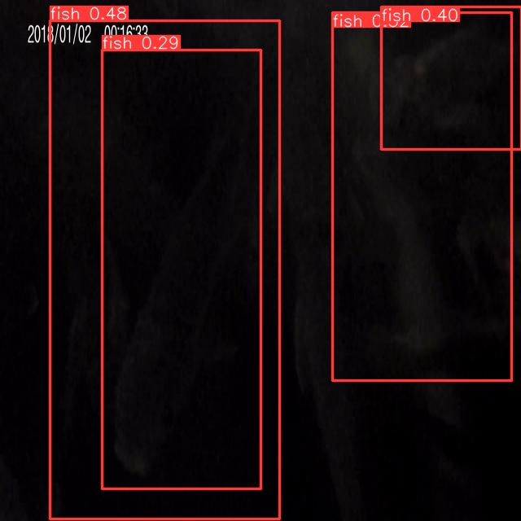
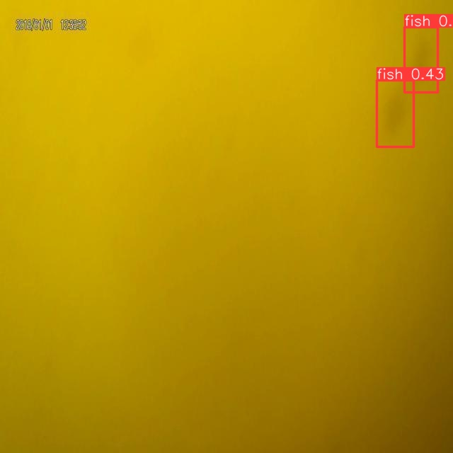
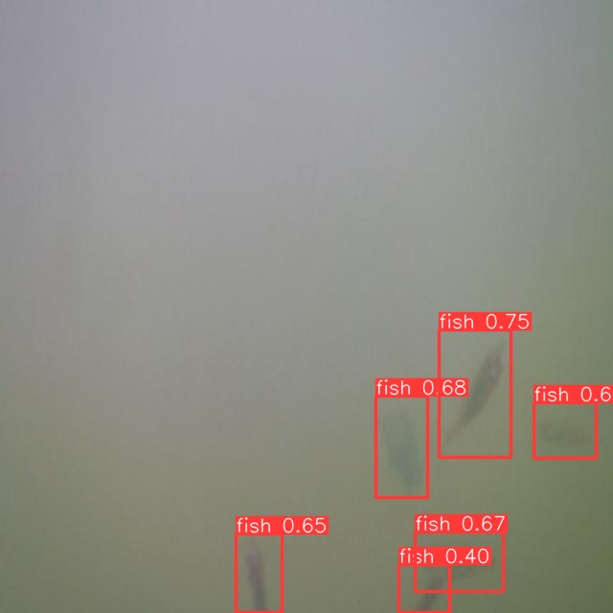
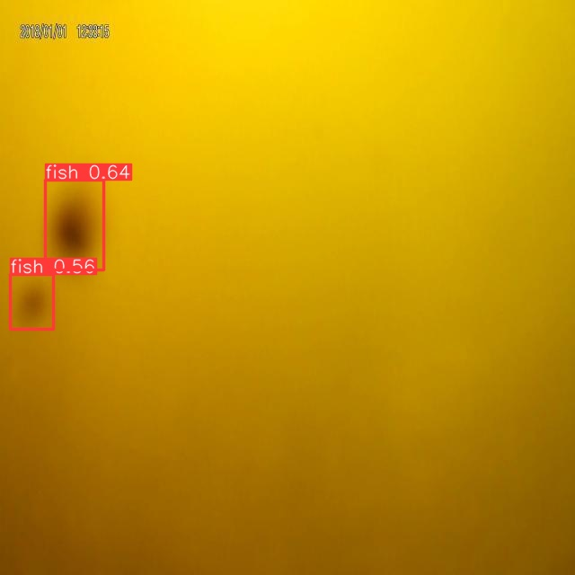
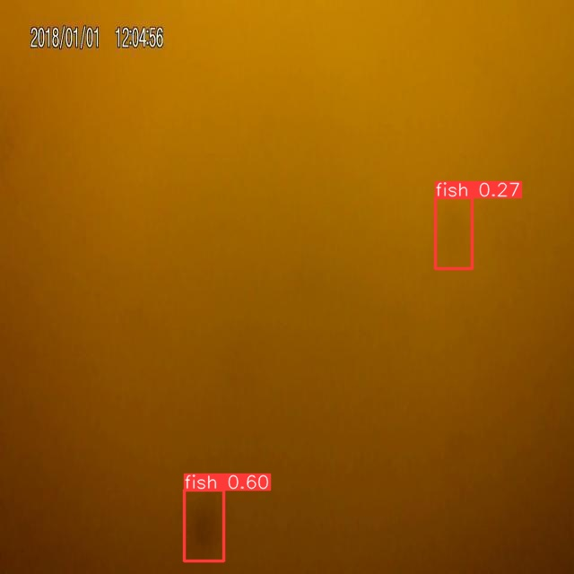
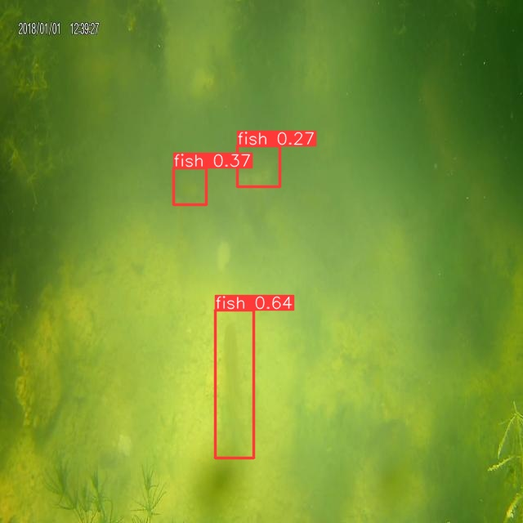
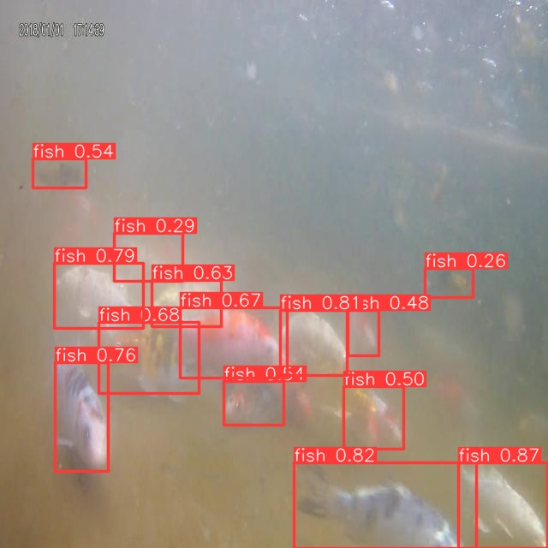
YOLOv8n predictions
The proposed algorithm exhibits good accuracy in cases where the fishes are extremely small, far off and with various distortions in the underwater images.

Slide 8
Future extensions
Detection performance can be achieved by training the model on a more diverse dataset, encompassing a wider range of object variations and scenarios.
Ensemble learning techniques, such as Non-max suppression and other methods, can be effectively utilized to enhance object detection performance by combining the predictions of multiple models.
Deployment of a high-performance API for expedited outcomes and accessibility
Hyperparameter tuning can be performed (computation power limitation)
Implementing and testing “Adaptive” image preprocessing techniques
Conduct thorough research and benchmarking of different quantization methods to optimize the performance of YOLOv8

Slide 9


Thank You !
Reach out to Sshubam Verma!
Reach out to Sparsh Jain!

